Slide 1
Programming Parallella
An Introduction
Shashi Bhushan

Slide 2
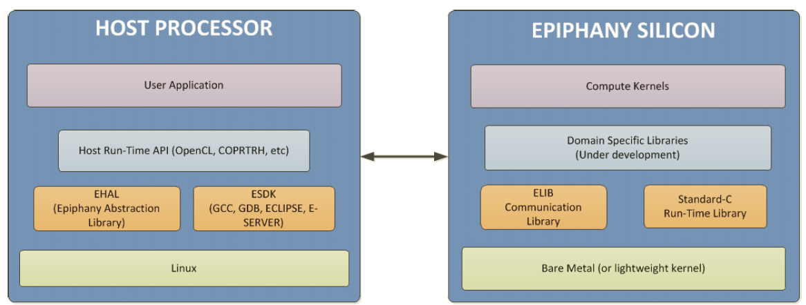
Introduction
There is a host(ARM chip in Zynq) and a device(Epiphany)
All programs and user files are stored in host(ARM chip)
The host consists of the Linux kernel and the and the epiphany application (including the source and host code)

Slide 3
Introduction cont.
There are always two programs, one for host and one for device
An epiphany workgroup is the rectangular collection of adjacent eCores
All eCores are referenced using the row and column number
Many workgroups can be allocated all of which run separate programs
Always make sure that no two programs are assigned same work group

Slide 4
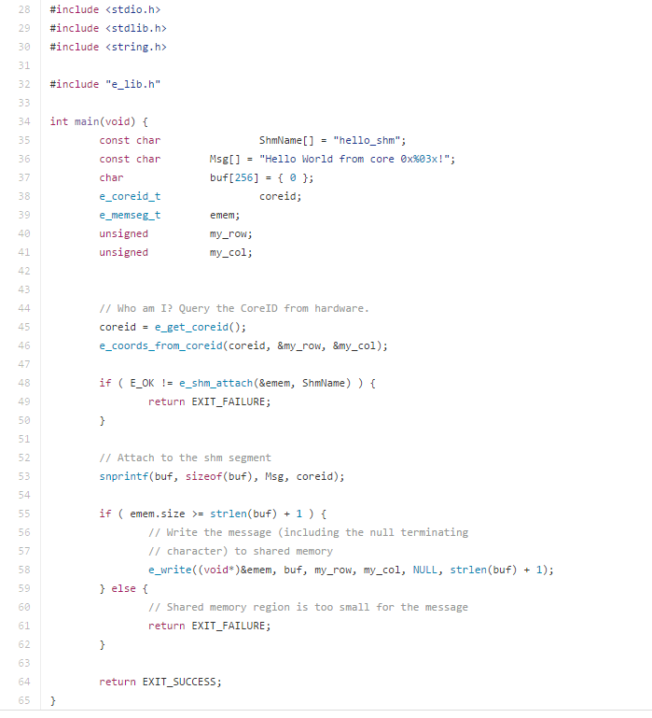
Hello World : Device program
As discussed, there are always two programs, a host program and a device program
Lets first discuss the device program(e_hello_world.c)

Slide 5
Hello World : Device program
Note inclusion of e_lib.h header file which provides various functions for eiphany
In line 45, we use function e_get_core_id which is used to access particular core. It does not contain any parameters
The core id is a 12 bit number where the first 6 bits correspond to the core’s row coordinate and last 6 bits correspond to the core’s column coordinates

Slide 6
Hello World : Device program
In line 53, we make the message to be written in shared memory. snprintf is used to direct the output of a print to a buffer
In line 55 – 59, we write the message in the shared memory if the shared memory has desired space
Otherwise we return FAILURE

Slide 7
Hello World : Host program
The host supervises the work of a device like transferring data to and from the device
The device cannot interact with memory or I/O devices on its own
The epiphany hardware abstraction layer(eHAL), also called epiphany host library is provided in e-hal.h
The library e-hal.h will always be included in the host program

Slide 8
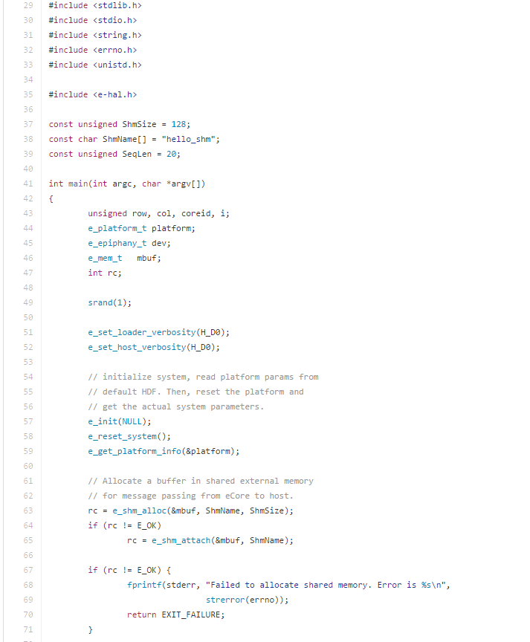
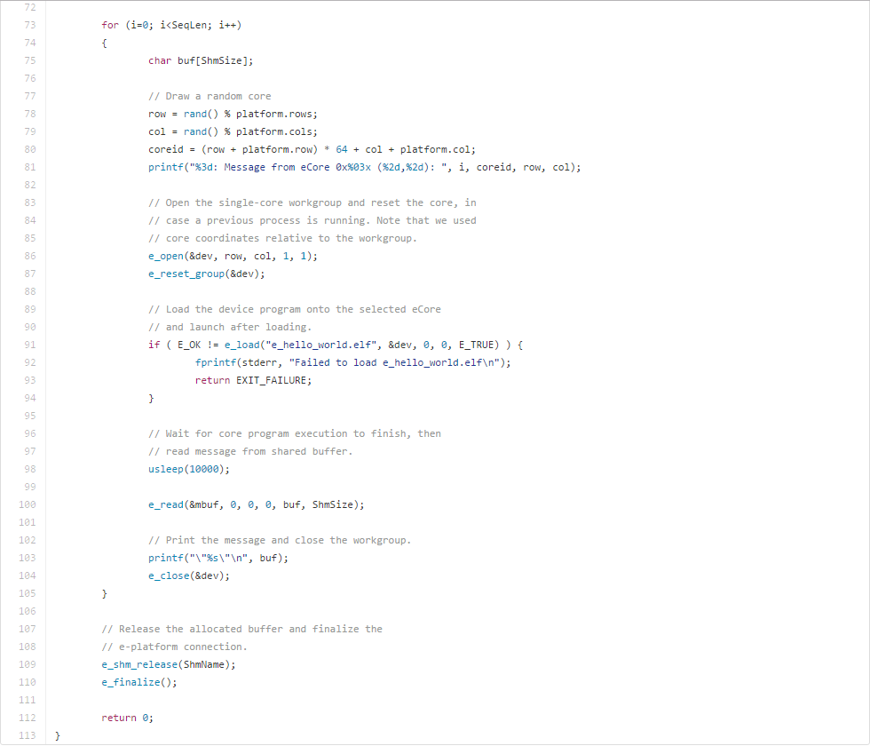
Hello World : Host program cont.

Slide 9
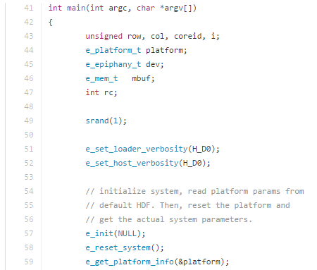
Hello World : Host program cont.
We have defined a variable named platform which is of e_platform_t type
Whenever we deploy a job to the epiphany platform, we launch a job to a particular Epiphany workgroup

Slide 10
Hello World : Host program cont.
The variable dev is of type e_epiphany_t which can store information on the e_Core workgroup
The variable mbuf is of type e_mem_t and can be used to keep track of memory on eCores
e_init is used to initialize the host library data structures and establish connection to the epiphany platform
e_reset_system resets the epiphany system
e_get_platform_info() gets the information on the epiphany platform, and stores is in the platform variable.

Slide 11
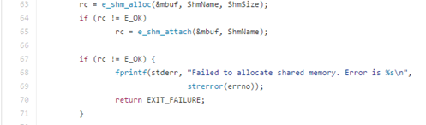
Hello World : Host program cont.
Here we allocate a buffer in the shared memory
This is used for passing messages from eCore to host
Note that the ShmName is a constant defined above which is same as one defined in device program

Slide 12
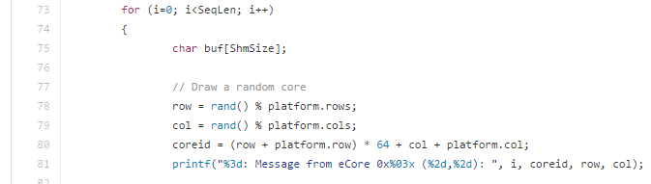
Hello World : Host program cont.
Here we are starting a loop. The program inside the loop is responsible for the behavior of the application
We use the rand() function to get a random value for the row and column. For this, we are using the row and column attribute of the platform object
We then use the row and column values to get the core id which is 12 bit number

Slide 13
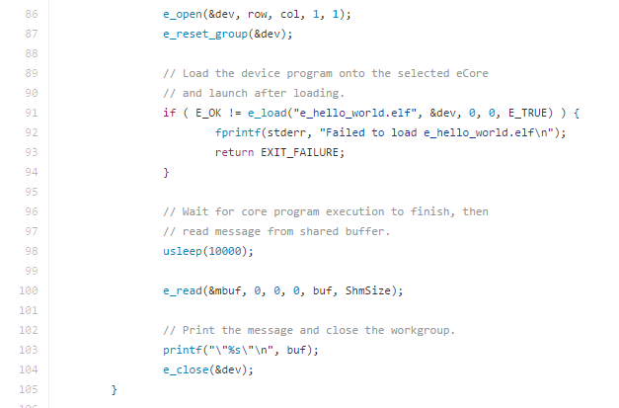
Hello World : Host program cont.
E_open defines a workgroup of the specified size starting at positions marked by row and column
The e_reset_group() function performs a soft reset of the group.

Slide 14
Hello World : Host program cont.
e_load() function is used to move the object file onto a workgroup core. The coordinates after that are relative to the workgroup
Here they are 0,0 as we are working on a single core. E_TRUE is used to start the function immediately
e_read() is used to read from the workgroup’s memory starting at relative row column values with the specified offset, and placing it into the specified buffer(buf) of size specified(ShmSize)
We then use the e_close function to close the workgroup

Slide 15
References
Epiphany SDK Reference manual http://adapteva.com/docs/epiphany_sdk_ref.pdf
http://suzannejmatthews.github.io/2015/06/02/epiphany-overview/
https://github.com/adapteva/epiphany-examples/tree/2016.3/apps/hello-world
http://suzannejmatthews.github.io/2015/06/03/epiphany-hello-world/

